Slide 1
Streams API
Streams Basics:
The two most important features added by JDK8
Lambda Expressions
Streams API
The steam API is designed with Lambda expressions in mind
Extensively used in streams
The key aspect of streams API is its ability to perform very sophisticated operations that search, filter, map or otherwise manipulate data.
Example: Using the streams API, you can construct sequence of actions that resemble the type of the database queries that you might use SQL: Declarative Language

Slide 2
Streams API
Such actions can be performed in parallel which provide high level efficiency, when large data sets are involved.
The streams API provides a powerful means of handling data in an efficient yet easy to use way.
Prerequisite: Generics and Lambda expressions.

Slide 3
Streams API
Define
Stream: is a conduit for data [A channel for conveying water or fluid: Dictionary]
A stream represents a sequence of objects
A stream operates on a data source: Array or Collection
No storage of data.
It moves data: filtering, sorting, otherwise operating on the data in the process.

Slide 4
Streams API
The general rule: sorting a stream does not change the order of the source. Rather, sorting a stream results in the creation of new stream that produces the new result.

Slide 5
Streams API
Stream interfaces:
BaseStream
Stream
Packaged in : java.util.stream.

Slide 6
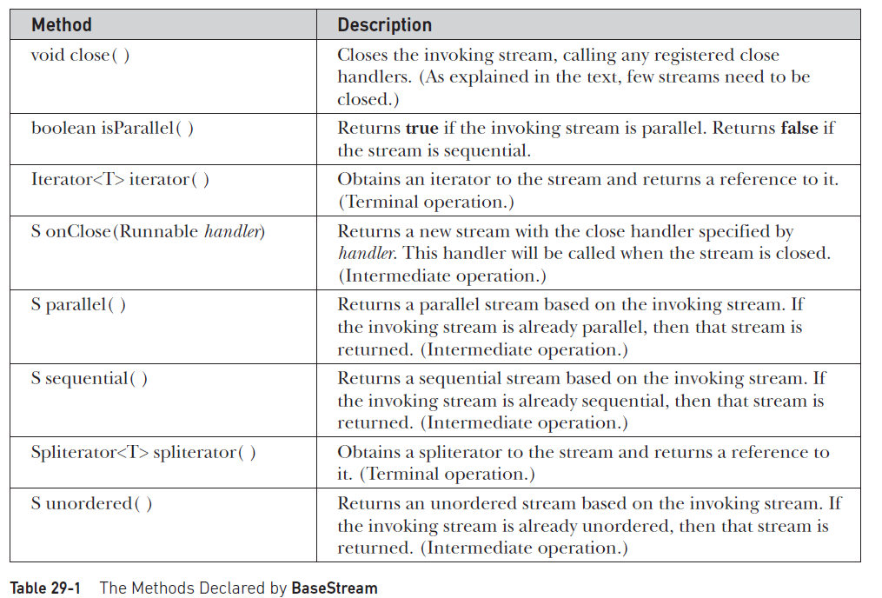

Slide 7
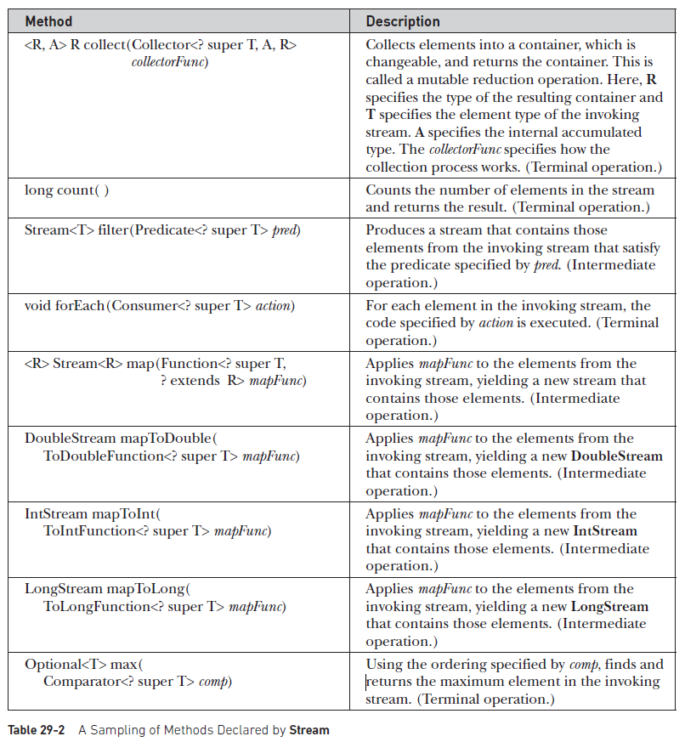

Slide 8
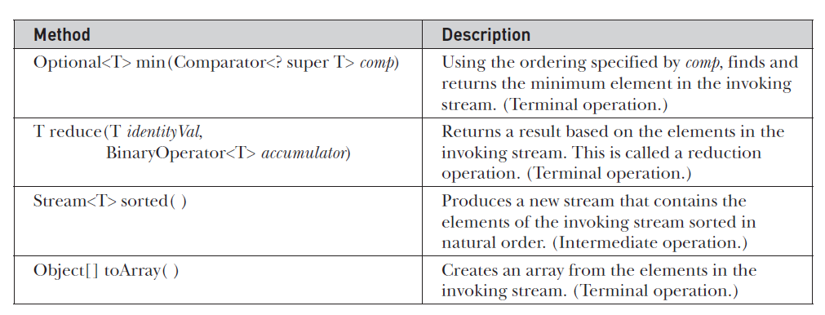
Streams API: Stream interface
The Stream interface extends the BaseStream
I addition to the methods that it inherits from BaseStream the Stream interface adds several of its own.

Slide 9
Streams API: Terminal and intermediate methods
Terminal operation: A terminal operation consumes the stream
It is used to produce a result, such as finding the minimum value in the stream.
Once the stream has been consumed, it cannot be reused. [exmple]

Slide 10
Streams API: Intermediate method
Intermediate operations produce another stream
The intermediate operations can be used to create a pipeline that performs a sequence of actions
Intermediate operations do not take place immediately, instead the specified action is performed when a terminal operation is executed on the new stream created by an intermediate operation
This mechanism is referred to as lazy behavior, and the intermediate operations are referred to as lazy.
The use of lazy behavior enables the stream API to perform more efficiently

Slide 11
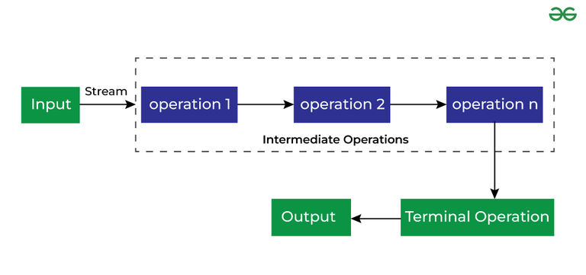
Streams API: Terminal and intermediate methods

Slide 12
Streams API: Intermediate operations are stateful or stateless
Stateless operation: Each element is processed independently of the others.
Filtering is stateless because each element is handled individually
Stateful operation: The processing of an element may depend on aspect of the other element.
Sorting is a stateful operation because an elements order depends on the value of the other elements
The difference between the stateless and stateful operations is important when parallel processing of a stream is desired because a stateful operation may require more than one pass to complete.

Slide 13
Streams API
Because Stream operates on object references, it can’t operate directly on primitive types.
To handle primitive type streams, the stream API defines the following interfaces:
DoubleStream
IntStream
LongStream

Slide 14
Streams API
These streams all extend BaseStream and have capabilities similar to Stream except that they operate on primitive types rather than reference types. They also provide some convenience methods, such as boxed( ), that facilitate their use. Because streams of objects are the most common, Stream is the primary focus of this chapter, but the primitive type streams can be used in much the same way.

Slide 15
Streams API
The Stream API is used to process collections of objects.
A stream in Java is a sequence of objects that supports various methods that can be pipelined to produce the desired result.

Slide 16
Streams API

Slide 17
Streams API

